Slide 1
Dynamic Programming-3
Lecture-8: Longest Common Subsequence(LCS) Problem
Md. Golam Shahriar,
Lecturer, Dept. of CSE, VU

Slide 2
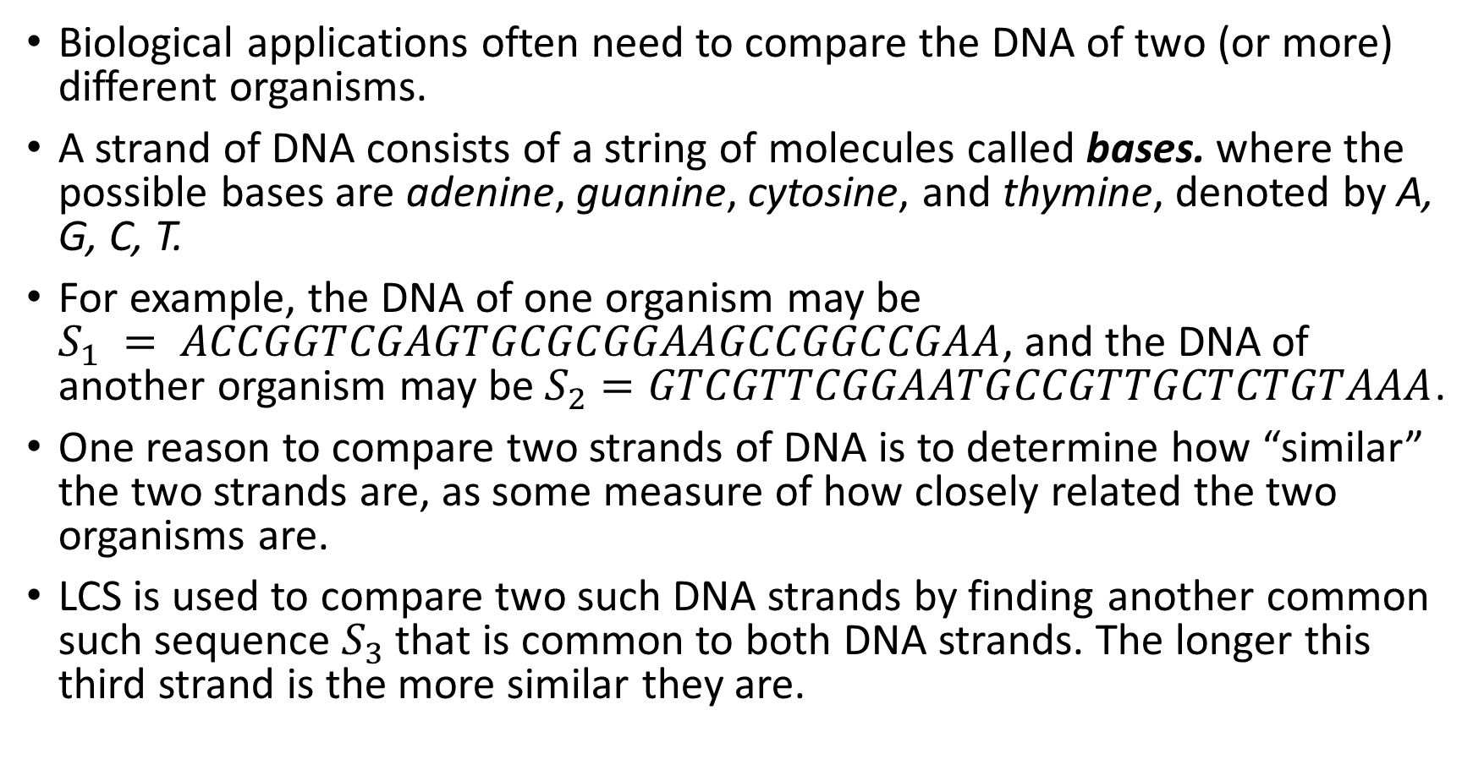
The Longest Common Subsequence Problem

Slide 3
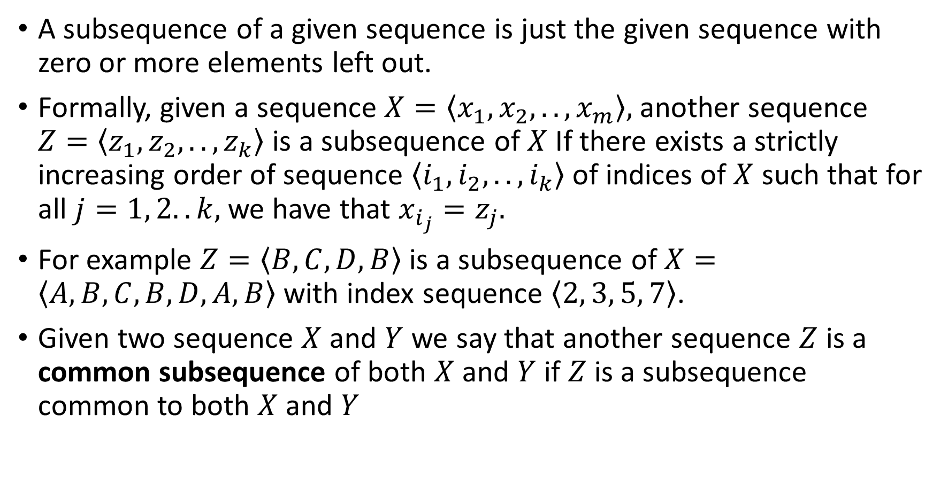
A Formal Mathematical Definition of LCS

Slide 4
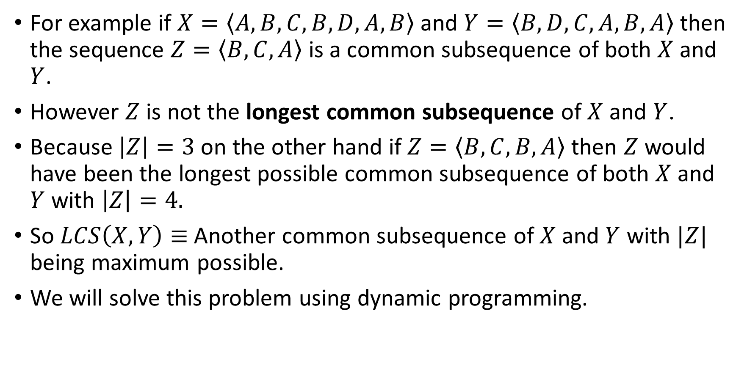
A Formal Mathematical Definition of LCS(Continued)

Slide 5
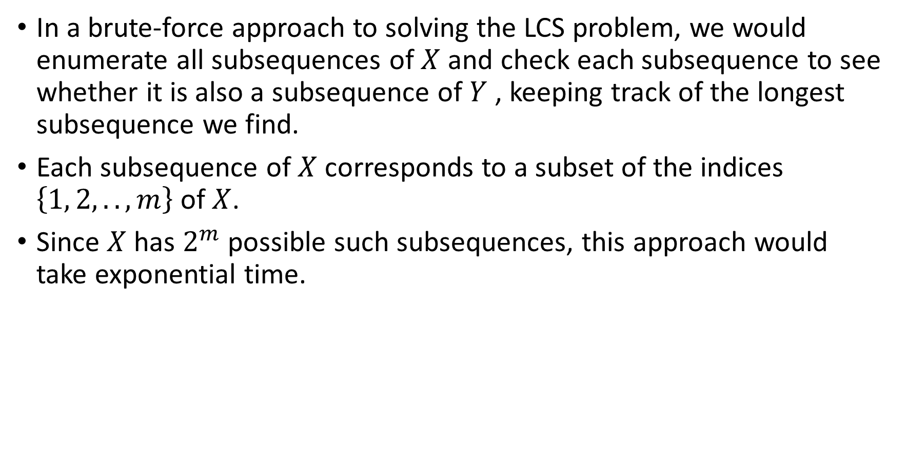
The Brute Force Approach

Slide 6
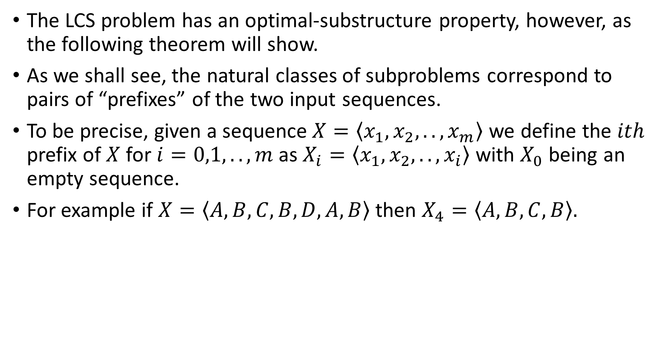
Characterizing the Optimal Substructure Property.

Slide 7
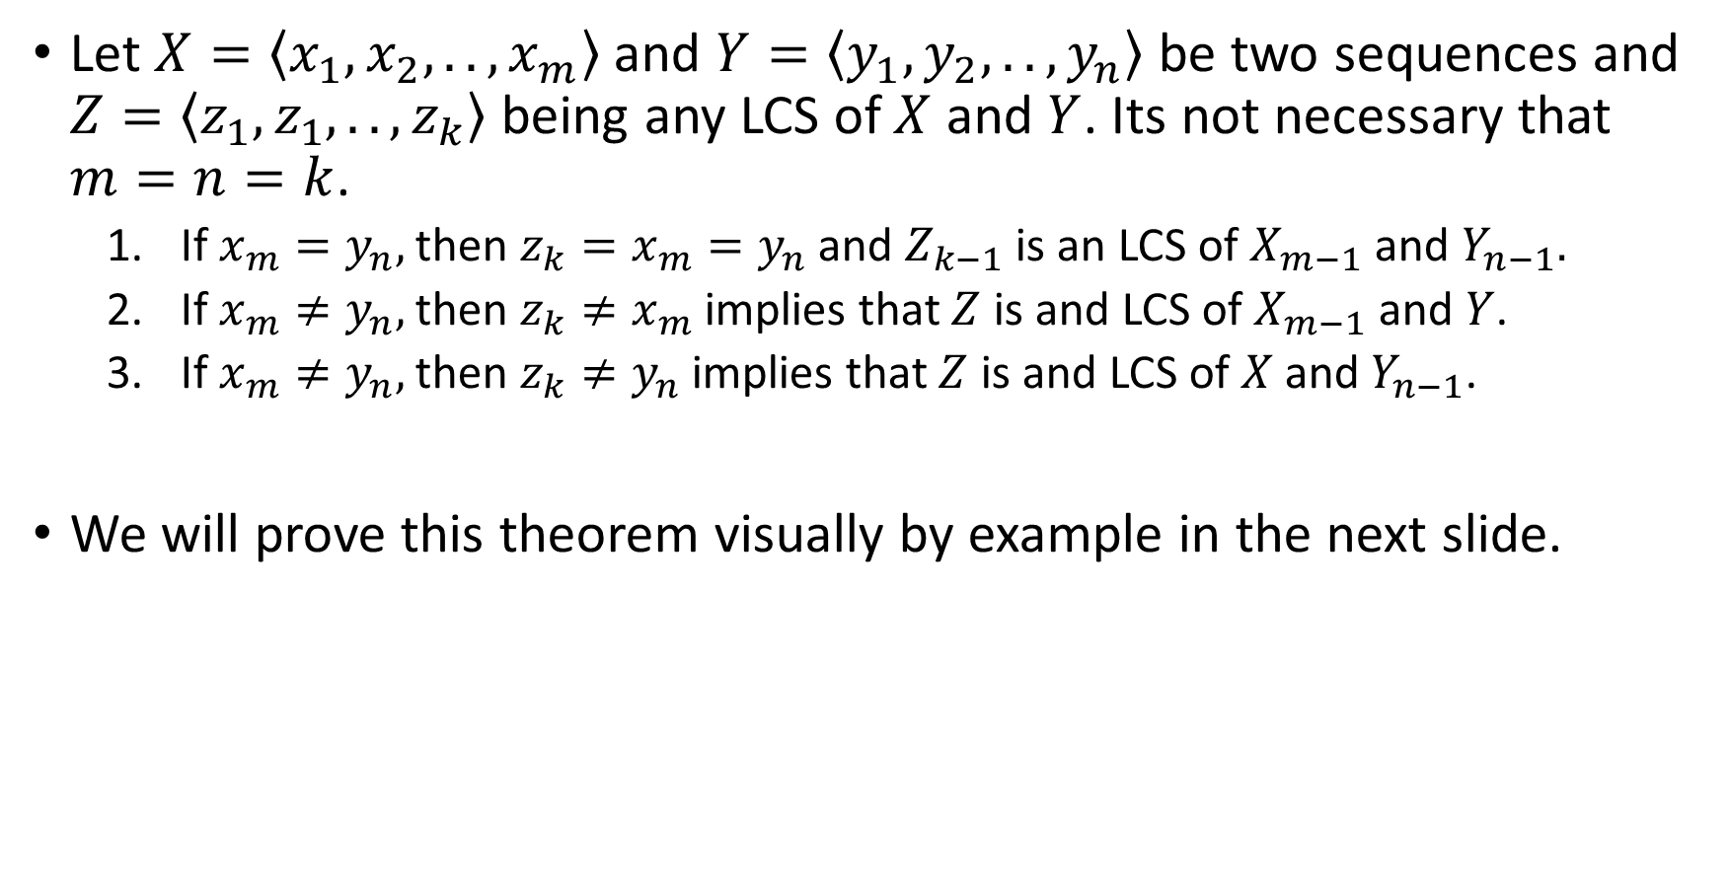
Theorem: Optimal Substructure of LCS

Slide 8
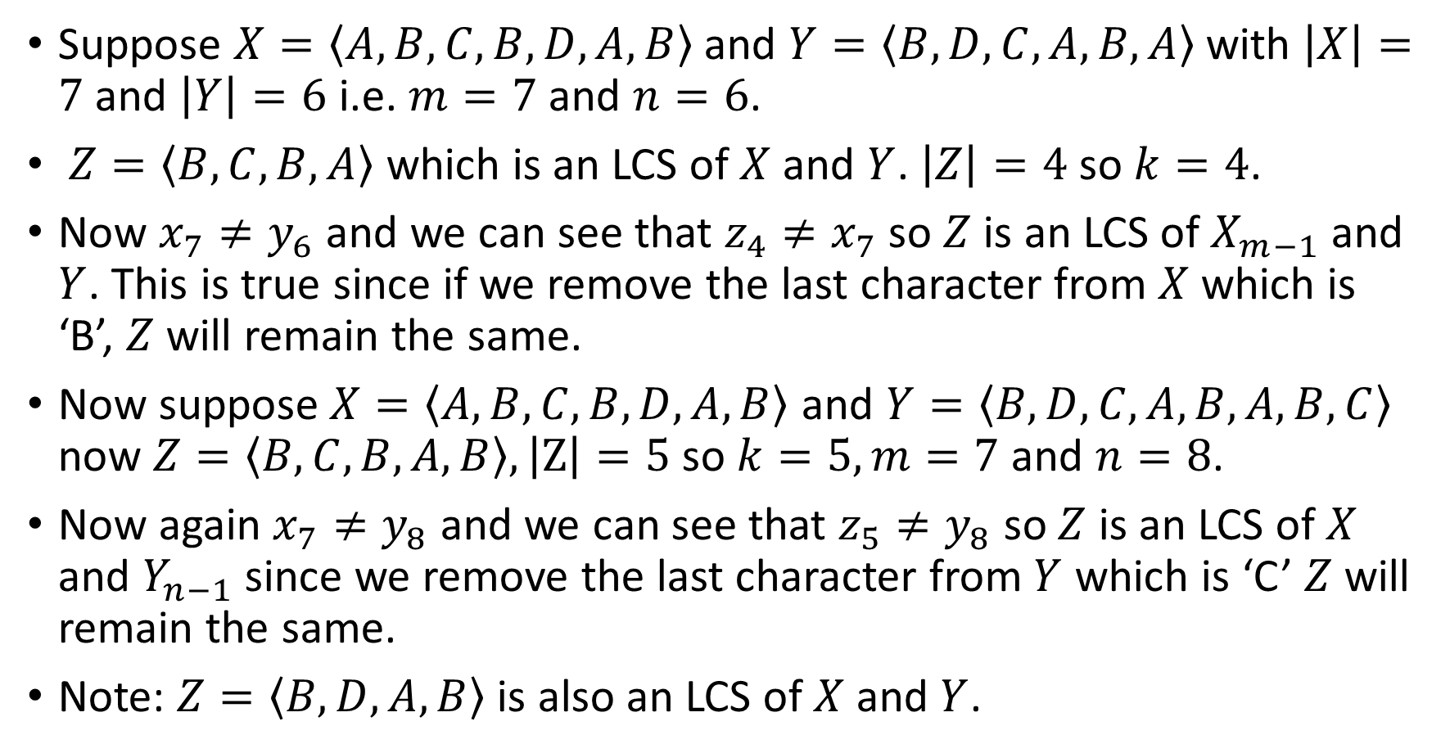
Proof of the Previous Theorem(2-3)

Slide 9
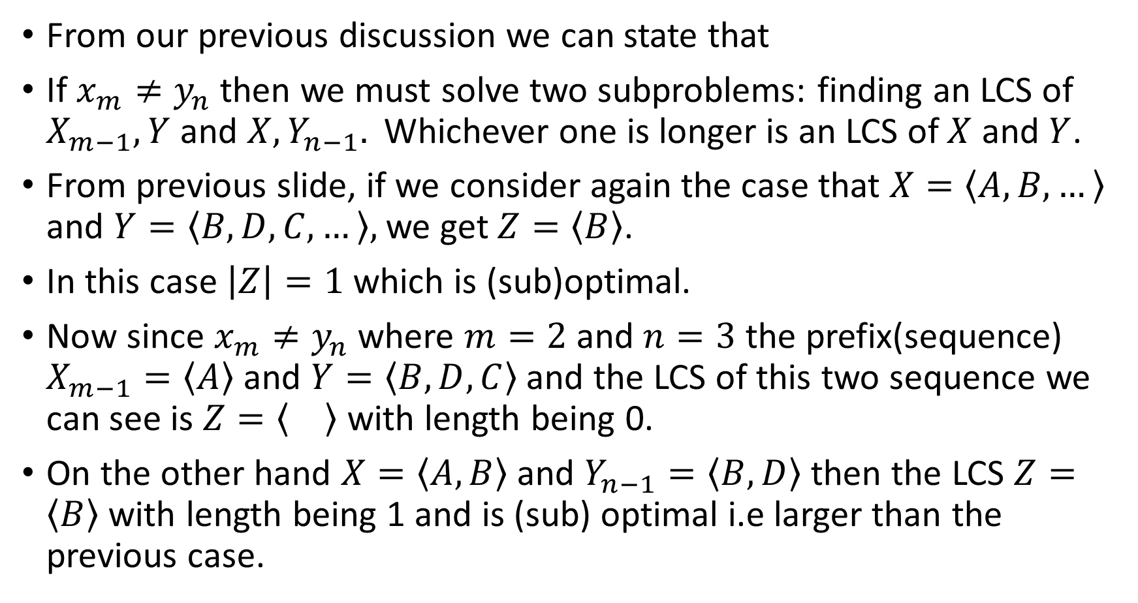
Proof of the Previous Theorem(2-3)

Slide 10
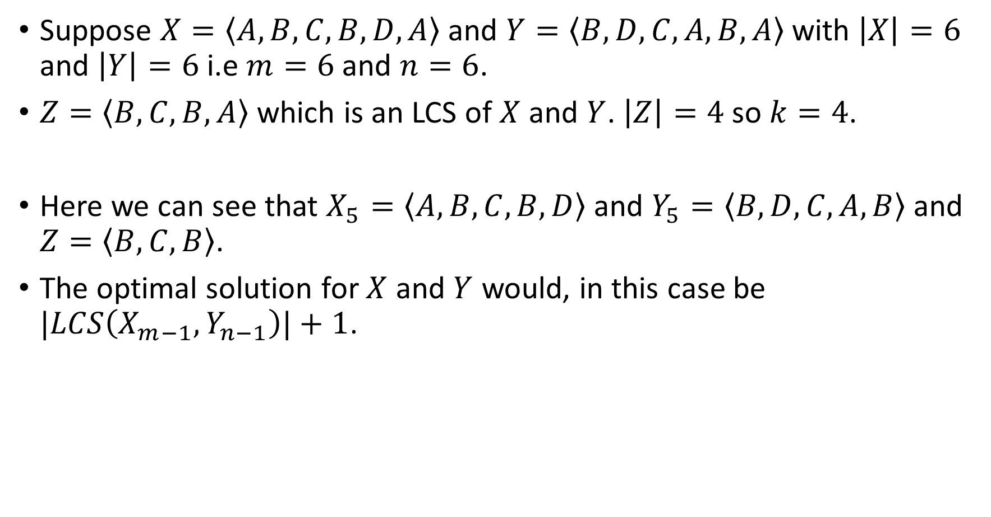
Proof of the Previous Theorem(1)

Slide 11
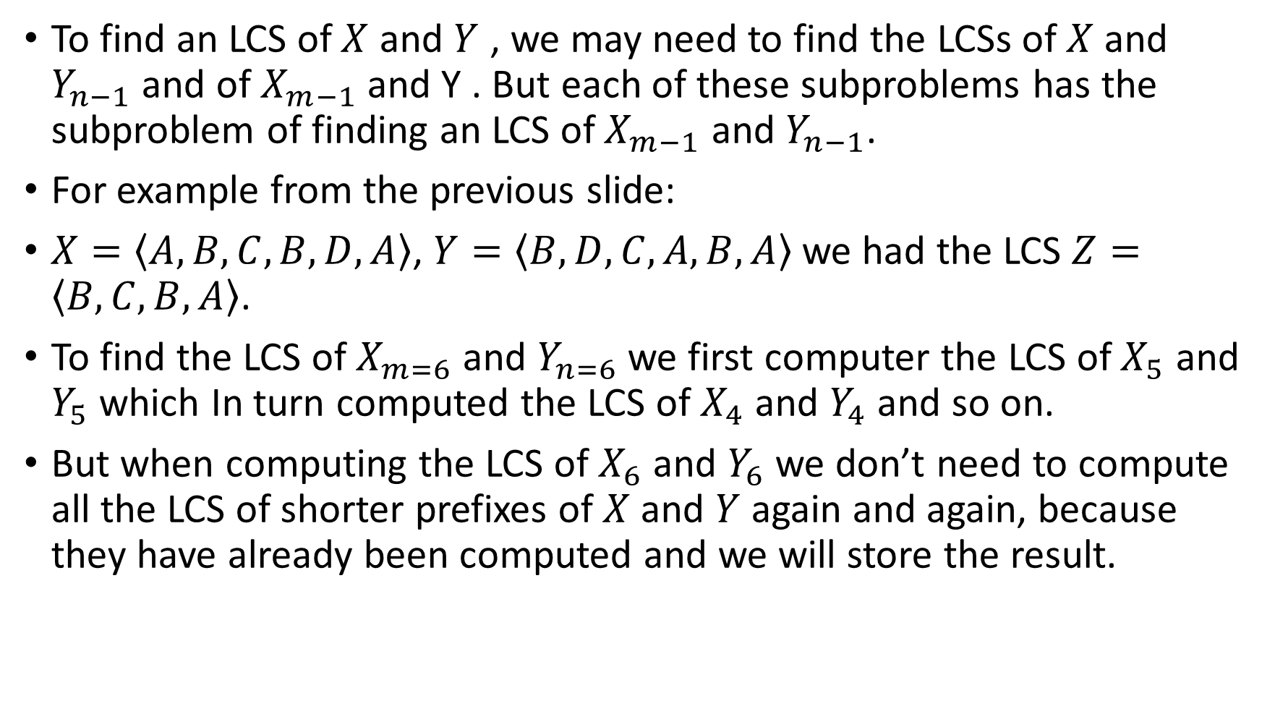
The Overlapping Substructure

Slide 12
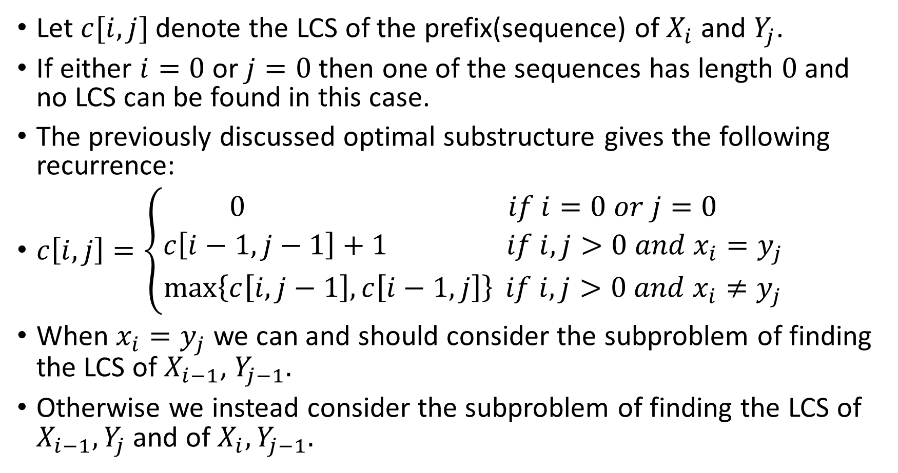
Establishing a Recurrence Relation

Slide 13
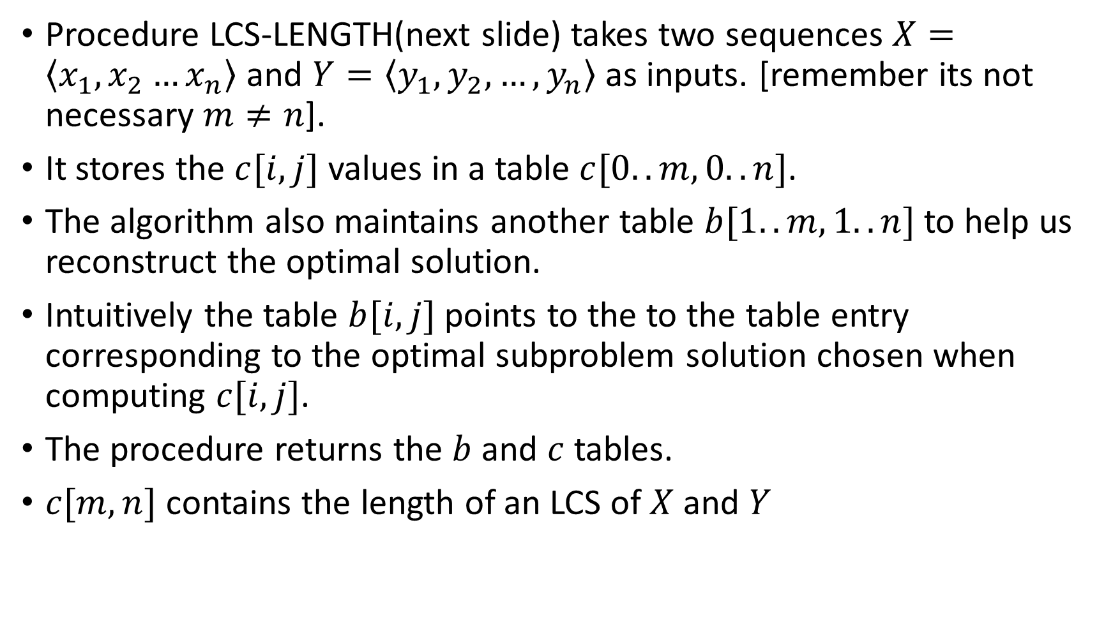
Computing the Length of LCS

Slide 14
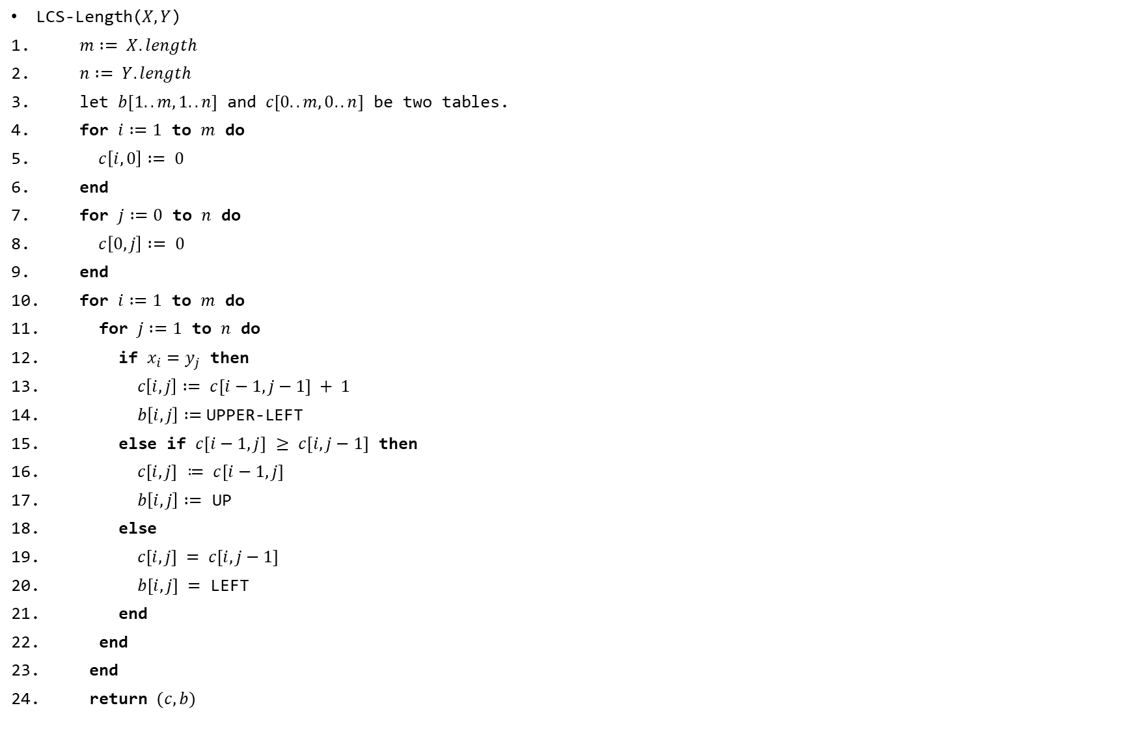

Slide 15
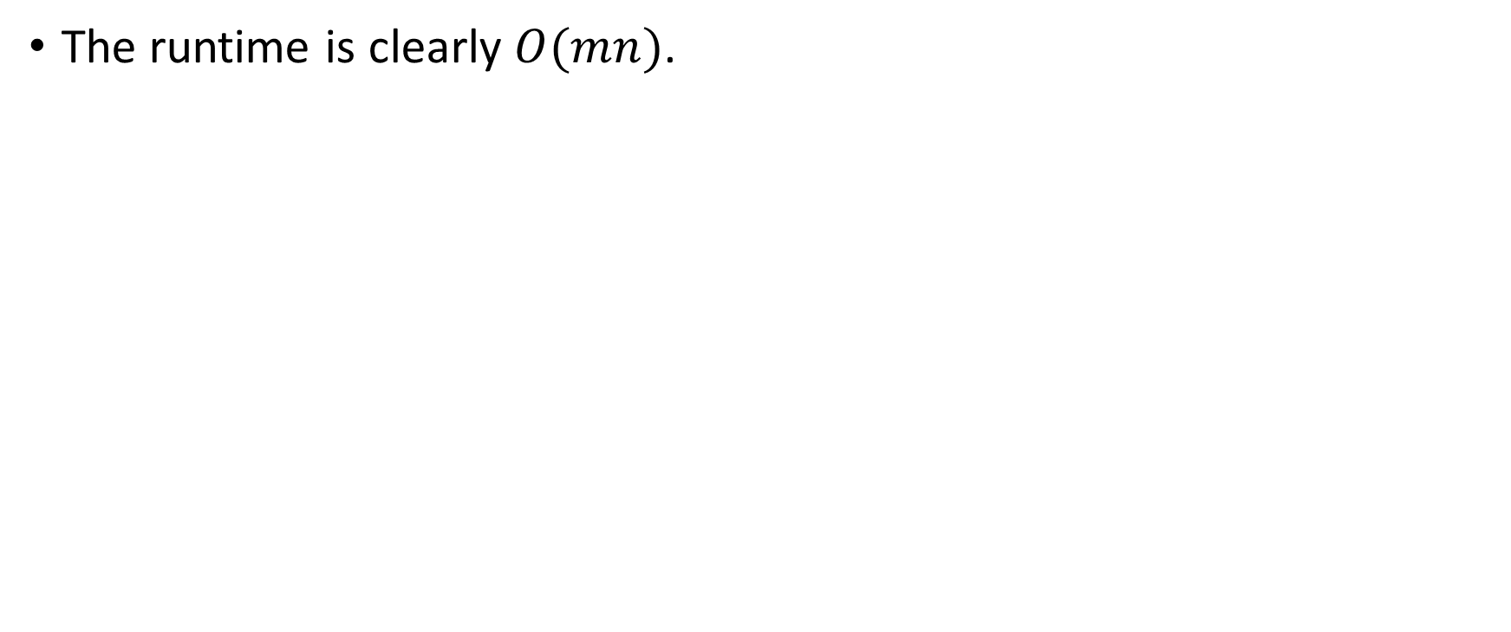
The Runtime of the Previous Algorithm

Slide 16
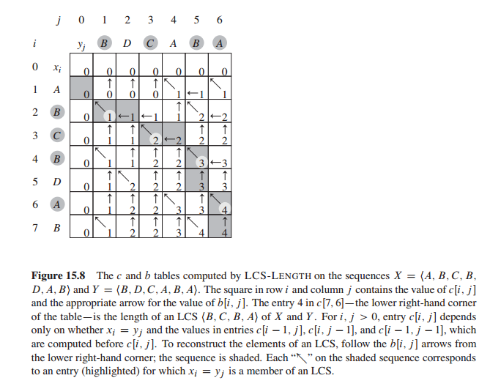

Slide 17
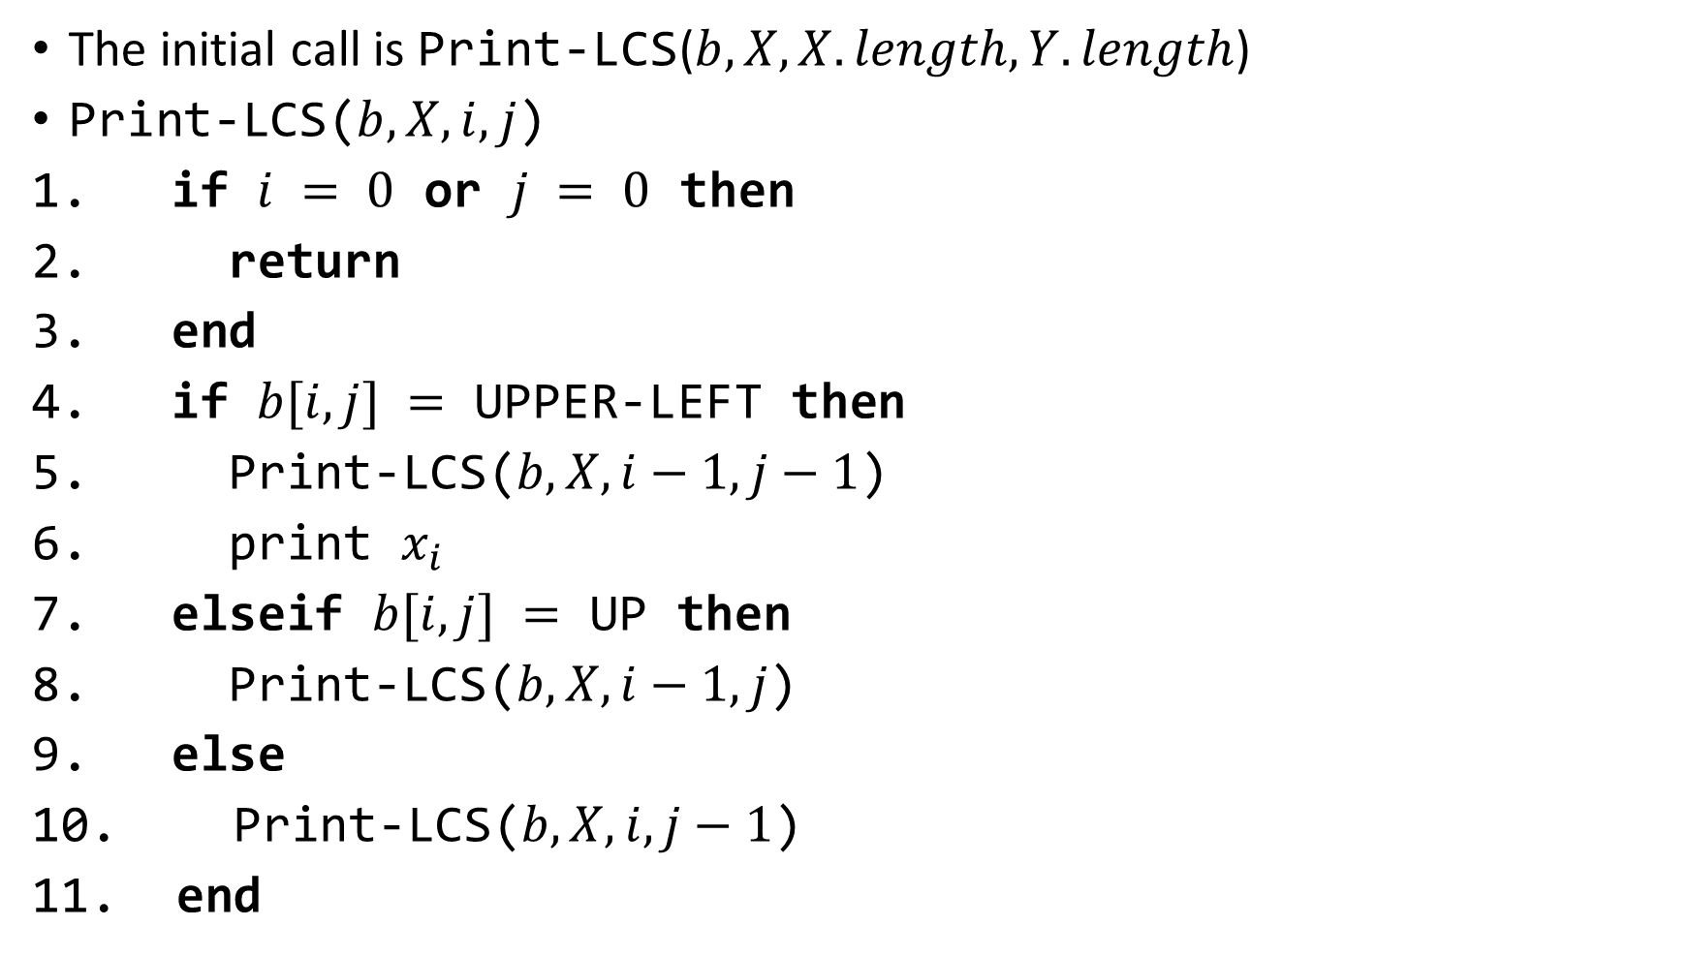
Reconstructing the Solution

Slide 18
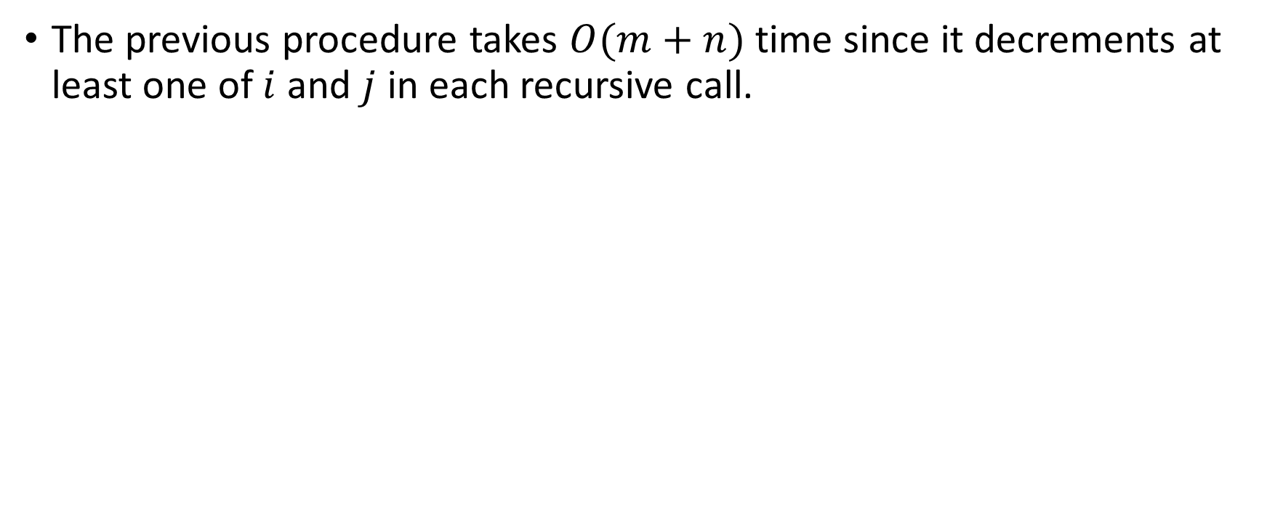
The Runtime of the Previous Procedure

